Slide 1

Topic: Access Control Principles and Tools in the Context of Information Security
By Ufuk Saylan

Slide 2
Introduction
Problem: Traditional security methods that focus only on the perimeter are not enough to protect against increasing threats.
1
Research Focus: Exploring access control methods and tools in information security.
2
Aim: To give a clear overview of access control concepts and how they are applied in real life real-world applications
3
Notes:
Today, I'll provide a comprehensive overview of access control concepts and their real-world applications, exploring how we can effectively manage who can access what in this complex environment. My aim is to give you both the theoretical foundation and practical insights needed to implement effective access control in your organizations.

Slide 3
Key Research Tasks
Analyze foundational access control principles
Examine theoretical access control models
Evaluate modern authentication and authorization technologies
Compare Identity and Access Management (IAM) solutions
Analyze Zero Trust architecture approach
Investigate impact of emerging trends
Explore implementation frameworks and real-world applications
Notes:
Our exploration today will cover seven key areas:
First, we'll examine the foundational principles that have shaped access control for decades. These are the building blocks upon which all access control systems are built.
Second, we'll look at theoretical models that provide frameworks for implementing access control in various contexts.
Third, we'll evaluate modern authentication and authorization technologies that verify identities and determine permissions.
Fourth, we'll compare various Identity and Access Management solutions available in today's market.
Fifth, we'll analyze the increasingly important Zero Trust architecture approach.
Sixth, we'll investigate how emerging trends are reshaping access control methodologies.
And finally, we'll explore practical implementation frameworks and real-world applications.

Slide 4
Foundational Access Control Principles
Least Privilege
Separation of Duties (SoD)
Need-to-Know
Defense in Depth

Slide 5
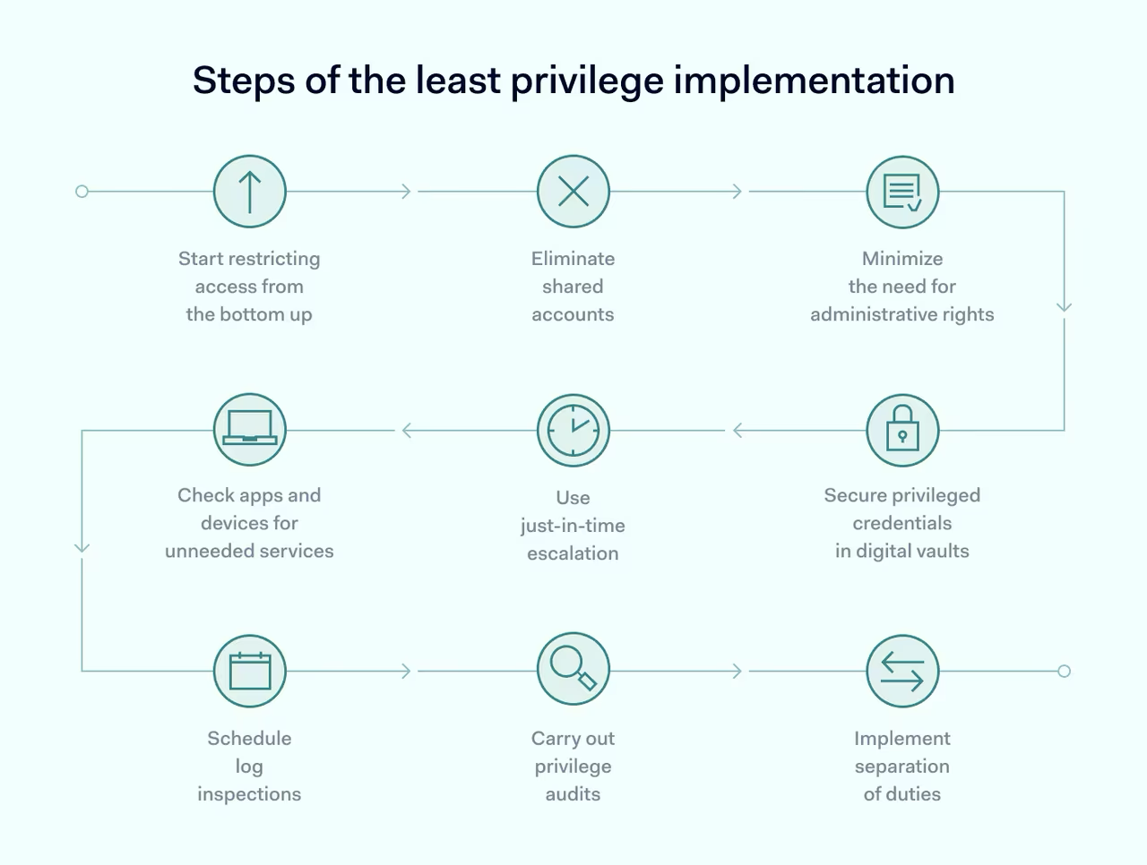
Least Privilege
Definition: Restricting access privileges to minimum necessary to accomplish assigned tasks
Origin: Developed as military protocol
Implementation: Just-in-time, just-enough-permissions access
Benefits: Mitigates insider threats, decreases potential attack range
Common Mistakes: Make a common task high privilege – everyone used to log in as admin for Windows
Notes:
The principle of least privilege is about restricting access privileges to the minimum necessary for users to accomplish their assigned tasks. It's a concept with military origins, now formalized by NIST as a fundamental security practice.
In practical terms, this means implementing just-in-time and just-enough-permissions access. Users receive only the permissions they need, only when they need them, and only for as long as they need them.
Think of it like giving someone a key that opens only one specific door in a building, rather than a master key, and having that key automatically expire when they no longer need access.
The benefits are substantial. By limiting access rights, organizations can significantly mitigate insider threats and reduce their overall attack surface. It's like reducing the number of doors left open in your building—fewer entry points means fewer opportunities for unauthorized access.

Slide 6
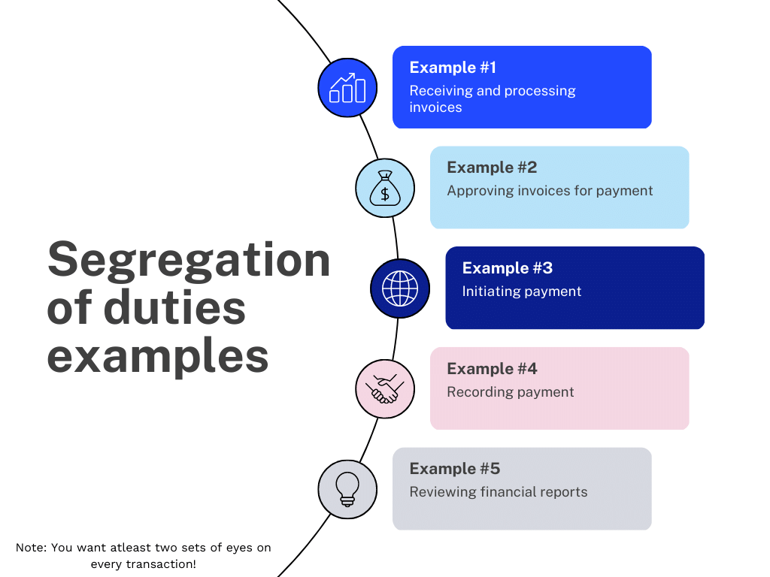
Separation of Duties (SoD)
Definition: No user should have enough privileges to misuse the system alone
Historical Context: Conceptual roots in ancient Rome and Greece
Implementation: Static definition of conflicting roles or dynamic enforcement at access time
Importance: Risk mitigation by distributing responsibilities
Notes:
The separation of duties principle has fascinating historical roots, tracing back to ancient Rome and Greece with the concept of divided power. It became more formalized in the 18th century through Montesquieu's concept of the "division of powers" in government.
In modern security terms, it means that no single user should have enough privileges to misuse the system on their own. For example, the person who approves a financial transaction shouldn't also be the one who initiates it.
This can be implemented either statically, by defining roles that cannot overlap, or dynamically, by enforcing controls at the time of access.
The importance of this principle lies in its ability to distribute responsibilities, creating natural checks and balances that reduce the risk of fraud, errors, and insider threats.

Slide 7
Need-to-Know
Definition: Access to information granted only when required for official duties
Modern Application: Often implemented through RBAC systems
Benefits: Enhanced resilience against internal/external attacks, reduced damage potential
This principle differs from least privilege in that need-to-know focuses on access to specific information, whereas least privilege refers to the broader set of permissions required to perform a job.
In moder enterprise, the need-to-know principle is often applied through Role-Based Access Control (RBAC) systems to manage and control access to shared data effectively, ensuring appropriate separation based on department and team member responsibilities.
Notes:
The need-to-know principle is about granting access to information only when it's required for official duties. While least privilege focuses on the permissions a user has, need-to-know focuses specifically on access to information.
In today's organizations, this principle is often implemented through Role-Based Access Control systems, ensuring team members only have access to the information necessary for their specific responsibilities.
This principle significantly enhances an organization's resilience against both internal and external attackers. By compartmentalizing information, it limits the potential damage from incidents like ransomware attacks, as attackers can only access a limited subset of data.

Slide 8
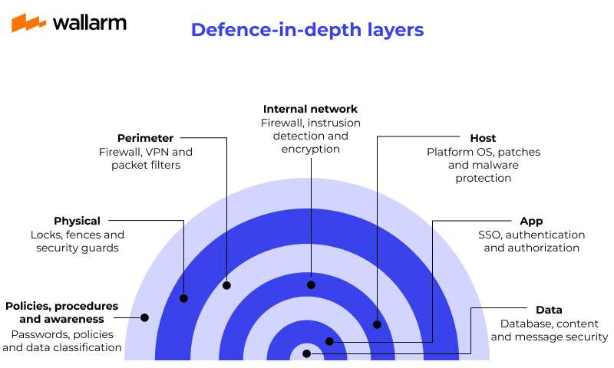
Defense in Depth
Concept: Multiple layers of security controls to provide redundancy
Origin: U.S. National Security Agency (NSA) strategy
Modern Implementation: Privileged Access Management, endpoint security, MFA, secrets management
Value: Reduces vulnerabilities, contains threats, mitigates risks
Notes:
Defense in depth is a concept developed by the U.S. National Security Agency, inspired by military strategy. It involves implementing multiple layers of security controls throughout an IT system.
In modern implementations, this includes technologies like Privileged Access Management, advanced endpoint security, adaptive multi-factor authentication, and secrets management solutions.
The value of this approach is that it reduces vulnerabilities, contains threats, and mitigates risks by ensuring that if one security layer is breached, subsequent layers continue to provide protection. It's like having multiple locks on your door—if an attacker picks one, they still have more obstacles to overcome.

Slide 9

Theoretical Models of Access Control
Role-Based Access Control (RBAC)
Attribute-Based Access Control (ABAC)
Context-Based Access Control (CBAC)
Notes:
Now let's turn to the theoretical models that give structure to access control implementations. These models provide frameworks for deciding who gets access to what resources under what conditions.

Slide 10
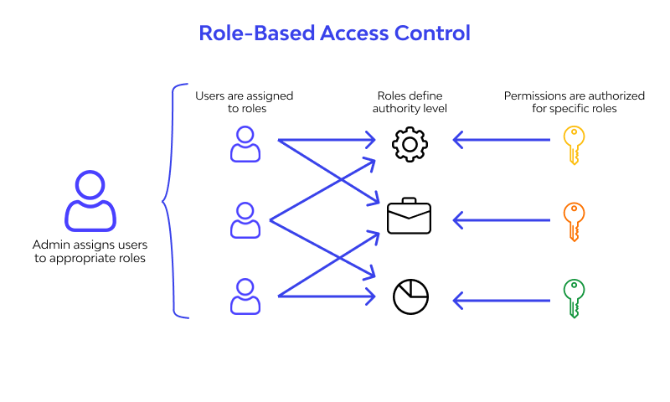
Role-Based Access Control (RBAC)
Definition: Access based on roles within organization
Fundamental Rules: Role assignment, authorization, transaction authorization
Advantages: Simplified management, improved efficiency, better compliance
Limitations: Requires thorough organization understanding, potential role explosion
Notes:
Role-Based Access Control restricts system access to authorized users based on their roles within an organization. It follows fundamental rules including role assignment, role authorization, and transaction authorization.
In practice, RBAC means that access rights are grouped by role, and users are assigned to appropriate roles. A hospital might have roles like "Doctor," "Nurse," and "Administrator," each with different access rights to patient records.
RBAC offers significant advantages, including simplified management of user access rights, improved efficiency in business processes, and better compliance with regulations. When implemented properly, it enforces both least privilege and separation of duties principles.
However, RBAC does have limitations. It requires a thorough understanding of your organization's structure and can become complex in organizations with many roles. In dynamic environments where responsibilities frequently change, RBAC can be less flexible, and organizations often face "role explosion" as they create numerous roles to accommodate various permission combinations.

Slide 11
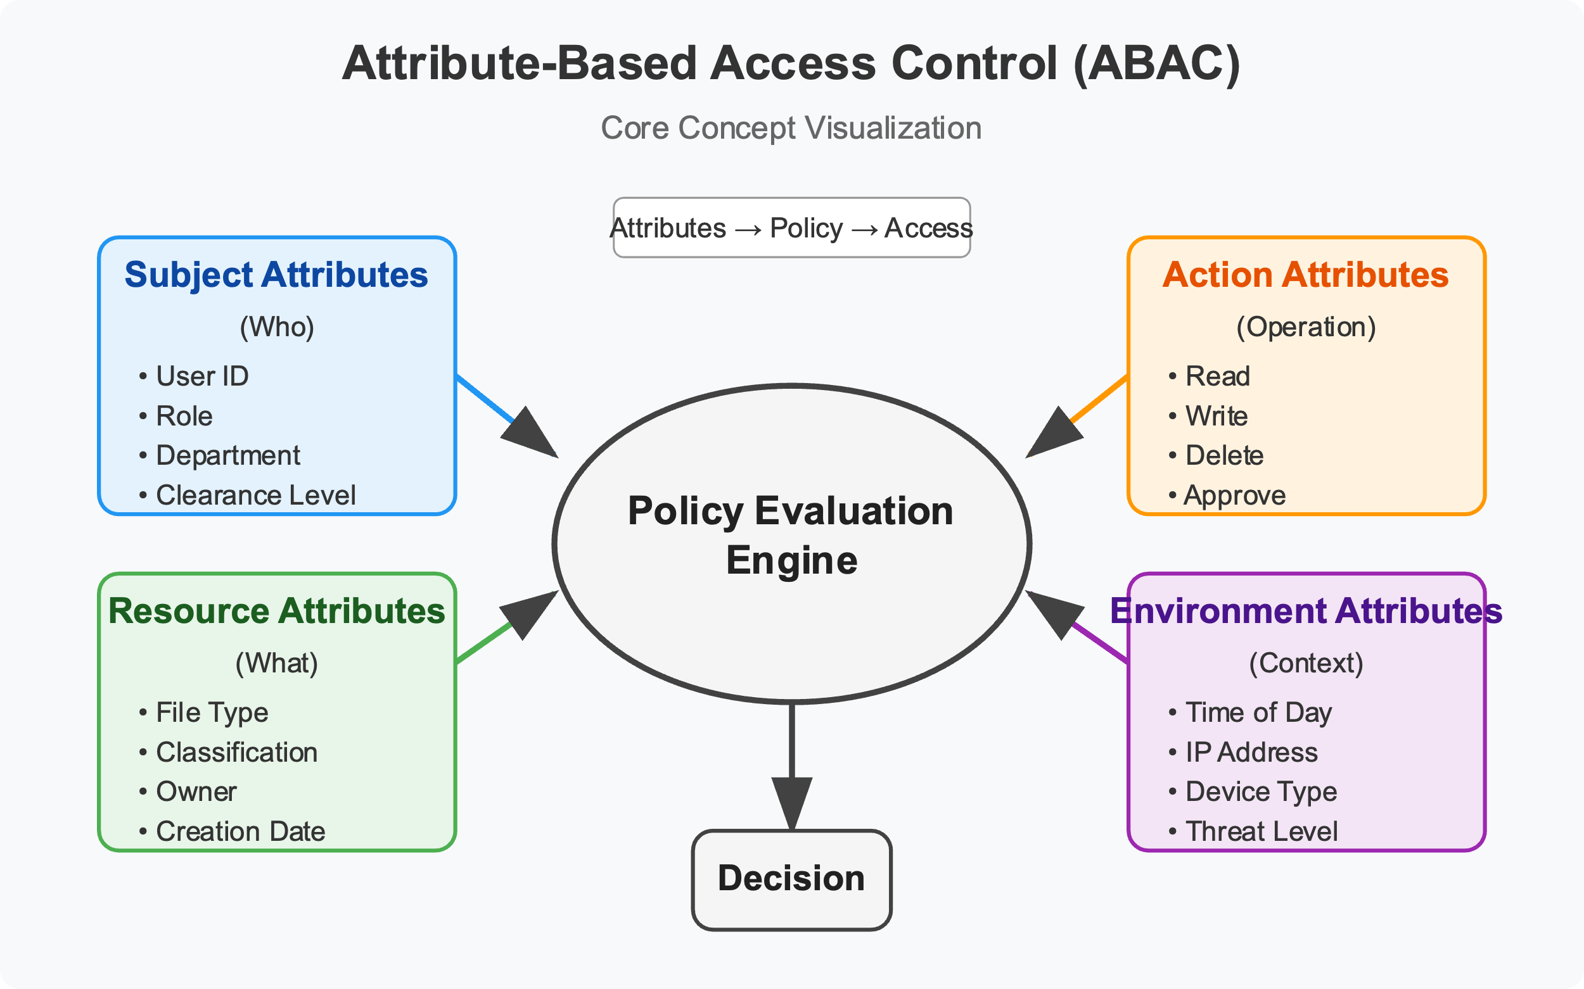
Attribute-Based Access Control (ABAC)
Definition: Authorization based on evaluation of attributes (user, object, operations, environment)
Advantages: Fine-grained control, dynamic decisions, enhanced flexibility
Challenges: Complex design and maintenance, potential performance concerns
Notes:
Attribute-Based Access Control takes a more flexible approach by evaluating multiple attributes to determine access. These attributes can include user characteristics, resource properties, environmental conditions, and more.
For example, an ABAC system might grant access based on a combination of the user's department, security clearance level, the sensitivity of the document, the time of day, and the user's location.
The advantages of ABAC include fine-grained control over permissions and dynamic access decisions that can adapt to changing circumstances. It's particularly well-suited for complex environments where access needs are variable.
However, ABAC comes with challenges. The systems can be complex to design and maintain, requiring significant expertise. Policy creation and management can become difficult due to the virtually limitless combinations of attributes, and there may be performance concerns as systems evaluate multiple attributes for each access request.

Slide 12
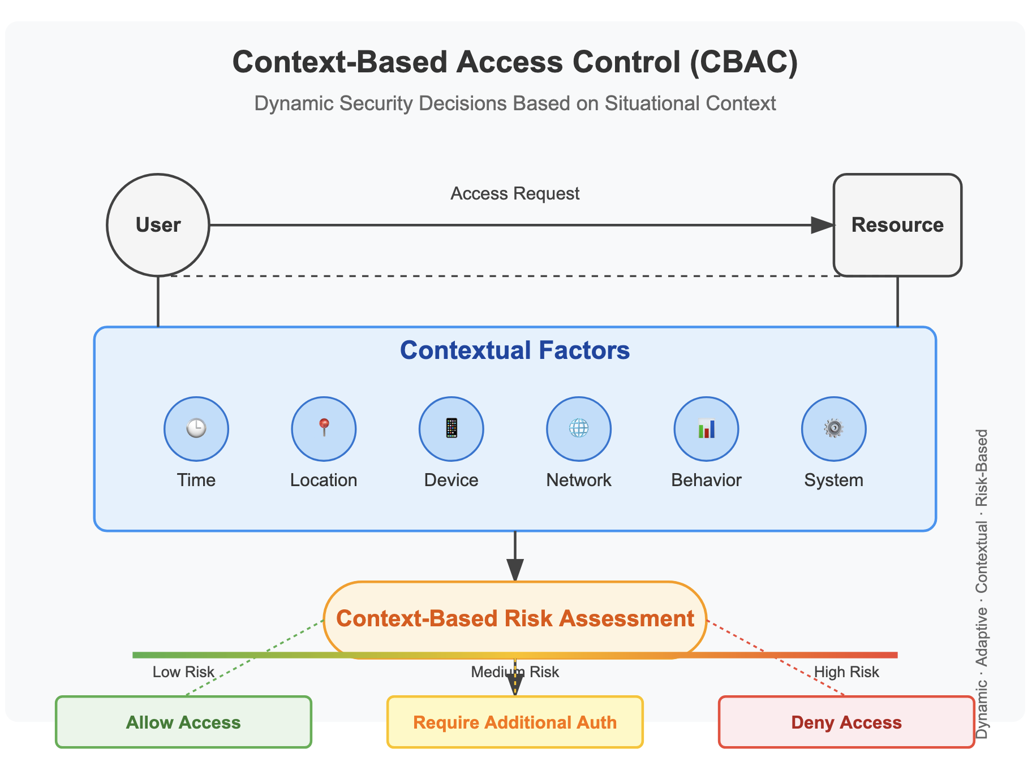
Context-Based Access Control (CBAC)
Definition: Considers contextual factors in access decisions
Implementation: Determines risk based on analytical, static, contextual attributes
Distinction: Extension of ABAC with focus on situational factors
Notes:
Context-Based Access Control extends traditional models by considering the context in which an access request is made. It enhances security during authorization by determining risk based on various attributes and computing a risk score.
For example, a CBAC system might restrict access to sensitive data during non-business hours or grant access only when the user is within a specific location.
While CBAC is technically an extension of ABAC, it focuses more on situational factors. Implementing CBAC requires careful planning to map authorization policies to attributes and manage the dynamic nature of contextual factors.

Slide 13
Modern Authentication Methods
Multi-Factor Authentication (MFA)
Biometric Authentication
Passwordless Authentication
Notes:
Authentication—verifying that users are who they claim to be—is the first step in access control. Traditional password-based authentication has proven insufficient against today's sophisticated threats, leading to the development of stronger methods.

Slide 14
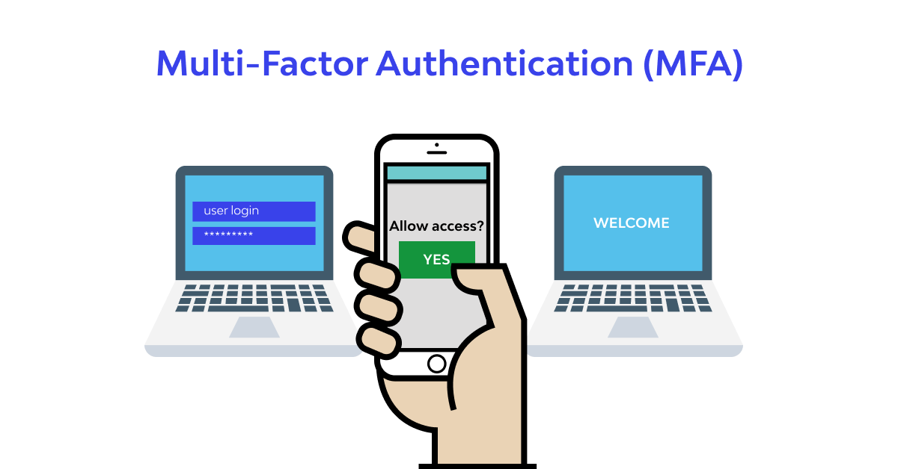
Multi-Factor Authentication (MFA)
Definition: Requires multiple authentication factors
Implementations: Authenticator apps, security keys, biometrics
Benefits: Creates additional security barriers
Challenges: Implementation complexity, potential user resistance
Notes:
Multi-Factor Authentication requires users to verify their identity using a combination of two or more distinct factors: something they know (like a password), something they have (like a security key), and something they are (like a fingerprint).
MFA can be implemented through various technologies, including authenticator apps that generate time-based codes, physical security keys, or biometric verification methods.
The security benefits are substantial. Even if a password is compromised, attackers still face additional barriers, significantly reducing the likelihood of successful breaches.
While MFA offers enhanced security, implementation can be complex, especially in organizations with legacy systems. User resistance to the additional steps can also be a challenge, requiring clear communication about the security benefits.

Slide 15
Biometric Authentication
Types: Fingerprint, facial, voice, iris/retina scanning, behavioral
Advantages: Based on unique traits, difficult to replicate
Limitations: Privacy concerns, implementation costs, false positives/negatives
Notes:
Biometric authentication verifies identity based on unique physical or behavioral characteristics. Common methods include fingerprint scanning, facial recognition, voice recognition, iris and retina scanning, and behavioral recognition, which analyzes patterns like typing speed.
The security advantage of biometrics is that they rely on unique traits that are extremely difficult for attackers to replicate. These traits are inherent to the individual, making them resistant to theft or loss.
However, biometrics do have limitations. Storing this data raises privacy concerns, as it could potentially be misused if breached. Implementation costs can be significant, and the systems may occasionally produce false positives or false negatives, requiring careful balancing of security and usability.

Slide 16
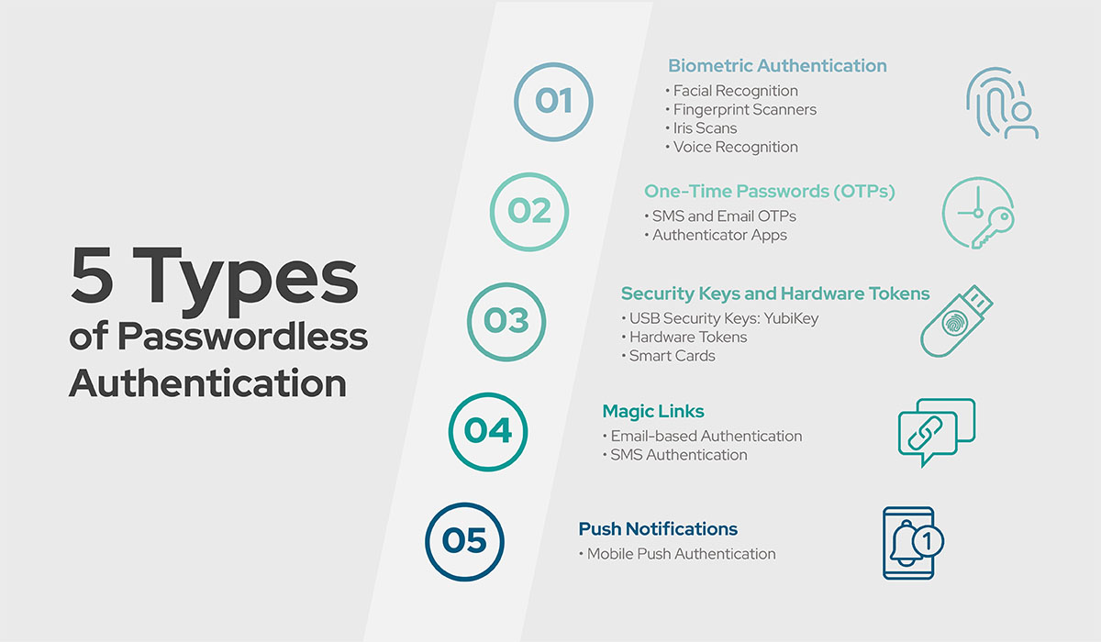
Passwordless Authentication
Mechanism: Authentication without password entry
Methods: Proximity badges, tokens, biometrics, mobile applications
Security Benefits: Reduces password-related vulnerabilities
Adoption Challenges: Legacy system integration, user adoption, implementation costs
Notes:
Passwordless authentication allows users to access systems without entering a password. Instead, it relies on alternatives like proximity badges, physical tokens, biometric recognition, or mobile applications.
By eliminating passwords, this approach reduces risks from common vulnerabilities like guessing, brute-force attacks, credential stuffing, and phishing. It can offer stronger security, especially when using standards like WebAuthn and FIDO2, which are designed to be resistant to phishing attacks.
Despite the benefits, adoption faces challenges. Integration with legacy systems can be complex, users accustomed to passwords may resist change, and there may be cost implications for new hardware and software. Nevertheless, passwordless authentication is becoming a key component of modern security strategies.

Slide 17
Authorization Frameworks
OAuth 2.0
Purpose: Framework enabling third-party limited access to HTTP services
Principle: Secure delegated access without sharing credentials
Process: Authorization code grant flow with token-based access
Application: Web services, API access management
Notes:
Once a user's identity is verified, authorization frameworks determine what actions they can perform. These frameworks provide standardized approaches to managing access permissions across applications and services.

Slide 18
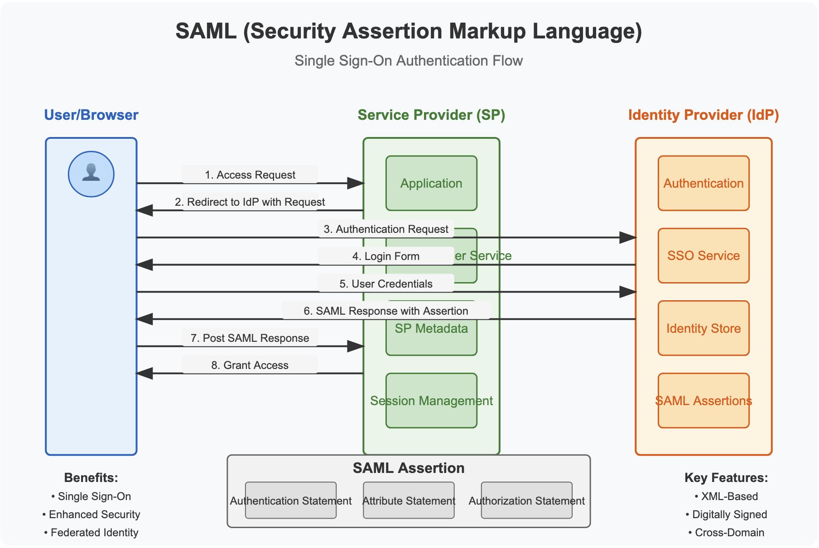
SAML (Security Assertion Markup Language)
Function: Open standard for authentication enabling Single Sign-On
Components: Identity provider (IdP) and service provider (SP)
Benefits: Improved user experience, increased security, reduced help desk costs
Use Case: Web application authentication across domains
Notes:
AML is an open standard used for authentication that enables Single Sign-On across web applications. It's an XML-based framework that transfers authentication data between an identity provider and a service provider.
The workflow involves the user attempting to access a service, the service requesting authentication, the identity provider creating an assertion containing user information, and the service provider granting access based on this assertion.
SAML offers improved user experience through SSO, increased security by not transmitting credentials to service providers, and reduced help desk costs from fewer password reset requests. While primarily for authentication, SAML assertions can include privilege information for authorization as well.

Slide 19
OpenID Connect (OIDC)
Nature: Identity authentication protocol built on OAuth 2.0
Process: Authentication via OpenID provider with ID token (JWT) delivery
Advantages: Standardization, JSON format, API-friendliness, mobile support
Applications: Federated login systems, integration with existing authentication
OpenID Connect (OIDC) is an identity authentication protocol that extends OAuth 2.0 by adding an identity layer. While OAuth 2.0 is primarily designed for authorization (determining what resources a client can access), OIDC focuses on authentication (verifying who the user is).
OIDC was developed by the OpenID Foundation and released in 2014 to address the need for a standardized, secure, and developer-friendly authentication protocol that works well with modern web and mobile applications.
Notes:
OpenID Connect builds on OAuth 2.0 by adding an authentication layer. While OAuth focuses on authorization, OIDC verifies user identity, often providing Single Sign-On capabilities.
The process involves the user accessing a relying party, which sends a request to an OpenID provider. After authentication, the provider sends back an ID Token (a JWT containing user information) and often an Access Token.
OIDC offers benefits including standardization, a readable JSON format, API-friendliness, and support for both web and mobile applications. It enables federated login and simplifies integration with existing authentication systems.

Slide 20
Identity and Access Management (IAM) Solutions
These tools provide a centralized platform for managing user identities, enforcing access policies, and ensuring compliance.
Notes:
Implementing effective access control requires robust Identity and Access Management solutions. These provide centralized platforms for managing identities, enforcing policies, and ensuring compliance.

Slide 21
Commercial Solutions
Common Features: MFA, passwordless authentication, privileged account management, RBAC
Leading Vendors:
Okta Workforce Identity Cloud
Microsoft Entra ID
Ping Identity Platform
CyberArk Workforce Identity
SailPoint Identity Security Cloud
Notes:
Seamless SSO Experience: An employee opens their Okta dashboard and sees personalized tiles for all authorized applications. One click grants access to Salesforce, Office 365, Workday, and custom internal applications without re-authentication. Contextual Access Policies: When a sales representative tries accessing CRM data from an airport Wi-Fi network, Okta automatically requires additional verification methods based on the unusual location. Lifecycle Management: When an employee transfers from marketing to sales, their manager initiates the change in Okta, which automatically revokes access to marketing tools while granting sales resources access—all orchestrated through pre-configured workflows. Commercial IAM solutions offer comprehensive features for modern enterprises. These typically include multi-factor authentication, passwordless options, privileged account management, role-based access control, and compliance capabilities.
Leading vendors include Okta Workforce Identity Cloud, which offers seamless SSO and extensive integrations; Microsoft Entra ID, with strong integration with Microsoft's ecosystem; Ping Identity Platform, featuring AI-driven orchestration; CyberArk Workforce Identity, focusing on privileged access; and SailPoint Identity Security Cloud, which emphasizes governance.
Each of these solutions offers different strengths, and the choice between them depends on an organization's specific needs, size, and complexity.

Slide 22
Open-Source Solutions
Advantages: Flexibility, customization options
Notable Options:
Keycloak
SuperTokens
WSO2 Identity Server
OpenIAM
Notes:
Open-source IAM solutions provide alternatives to commercial products, often with greater flexibility and customization options.
Notable options include Keycloak, an enterprise-grade solution supporting various protocols; SuperTokens, which is developer-friendly with pre-built components; WSO2 Identity Server, offering comprehensive features for different application types; and OpenIAM, a converged platform including governance and privileged access management.
These solutions provide extensive functionality while being free to use, with the added benefit of customization. However, they may require more technical expertise for implementation and management compared to commercial alternative

Slide 23
Zero Trust Architecture
Core Principles
Continuous verification: "Never trust, always verify"
Least privilege access: Minimum permissions necessary
Assume breach: Design security assuming network compromise
Network segmentation: Isolate network segments
Contextual access controls: Multi-attribute access decisions
Notes:
Zero Trust is a security framework that fundamentally shifts how organizations approach security. Unlike traditional security models that operate on the principle of "trust but verify" and focus on perimeter defense, Zero Trust operates on the principle of "never trust, always verify." It assumes that threats exist both outside and inside the network, eliminating the concept of a trusted network entirely.
Zero Trust is built on five core principles:
First, continuous verification—the "never trust, always verify" approach requires authentication, authorization, and validation for all access requests, regardless of where they originate.
Second, least privilege access ensures users and systems have only the minimum permissions necessary for their tasks, reducing the potential impact of compromised accounts.
Third, we assume breach—operating as if the network is already compromised to design security accordingly, focusing on limiting lateral movement and containing breaches.
Fourth, network segmentation divides the network into isolated segments to contain potential breaches and limit an attacker's ability to move laterally.
Finally, contextual access controls base decisions on multiple attributes including identity, device health, location, and behavior, enabling more nuanced and risk-aware security decisions.

Slide 24
Implementation Strategies
Define the protect surface
Establish zero trust policy
Strengthen endpoint security
Enhance monitoring and analytics
Automate security responses
Segment networks and applications
Define granular access controls
Continuously validate trust
Notes:
Implementing Zero Trust involves several key strategies:
Begin by defining your protect surface—identifying critical assets, data, and services that need protection. Establish clear Zero Trust policies for managing access to resources. Strengthen endpoint security to ensure devices are secure before allowing access. Enhance monitoring and analytics for visibility into network activity.
Additionally, automate security responses based on risk assessments, implement network and application segmentation, define granular access controls based on least privilege, and continuously validate trust for all access attempts.
This approach provides a framework for organizations to systematically improve their security posture in response to evolving threats.

Slide 25
Key Conclusions
Traditional access control principles remain critical but require modern implementation
Various access control models offer different advantages for specific organizational contexts
Modern authentication methods significantly strengthen identity verification
Standard authorization frameworks enable secure access in distributed environments
Zero Trust architecture represents fundamental shift from perimeter-based security
Effective implementation requires balancing security with usability

